Slide 1

Hydrone: Innovative drone technology for lake conservation management
Team Name

Slide 2

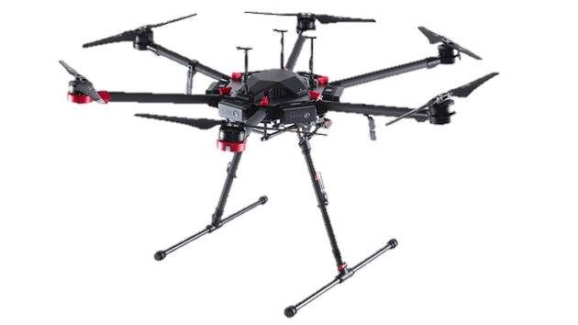
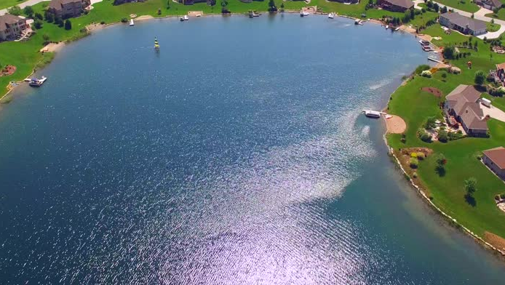
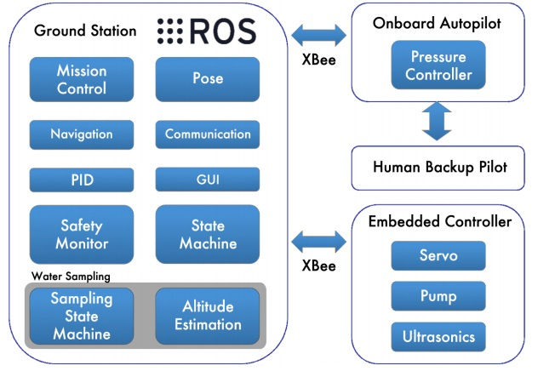
Transmit water quality data to backend
2
1
Hydrone
Lake Sampling
3
Problem Statement
A Clean, Safe, Healthy & Productive Lake Monitoring for Sustainable Development
Method
Autonomous drone
On-board Water Quality Sensor
Real-time Monitoring
Expected Outcome
Prototype of sampling mechanism for novel drone attachment for UM Tasik Varsity conservation Management

Slide 3
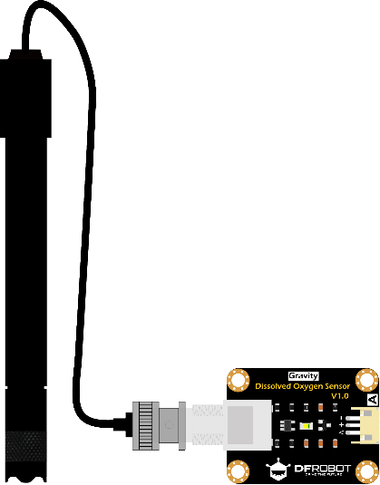
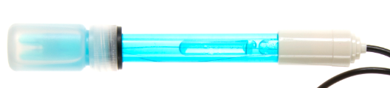
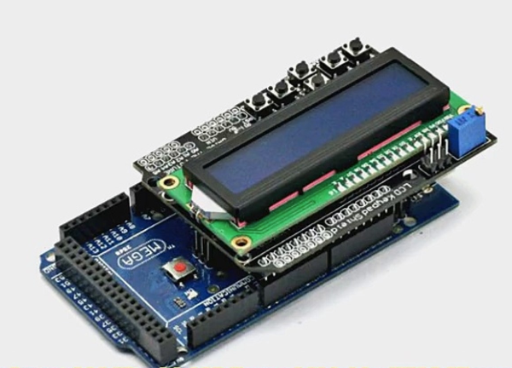
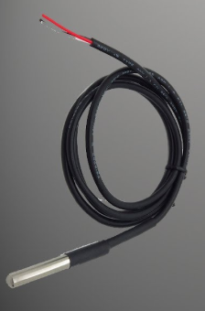
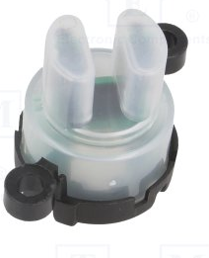
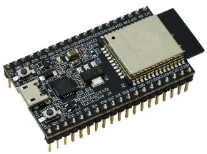
Water Quality Measurement Device
pH Sensor
Portable Device with Display for offline monitoring
Dissolved Oxygen Sensor
WiFi enabled MCU for Online connectivity
Turbidity Sensor
Temperature Sensor

Slide 4
To improve lake sampling, we propose the our drone called the Hydrone
The drone will fly semi-autonomously and land on the body of water
It will conduct real time water sampling and the data will be available for analysis on the backend
To eliminate the dependency on connectivity, the water sampler can store data offline and the on board LCD can display the measured parameters
Analytics will be performed on the data collected and will data visualization techniques will be used to communicate the information effectively to the stakeholders.

